Slide 1
ETL Project
Patricia Wong

Slide 2
Occupational salaries according to states
This project focuses on the extraction, transformation and loading of data taken from the Department of Labor website for the month of May 2018. The states used were Georgia, Illinois and New York.

Slide 3
Libraries utilized

Slide 4
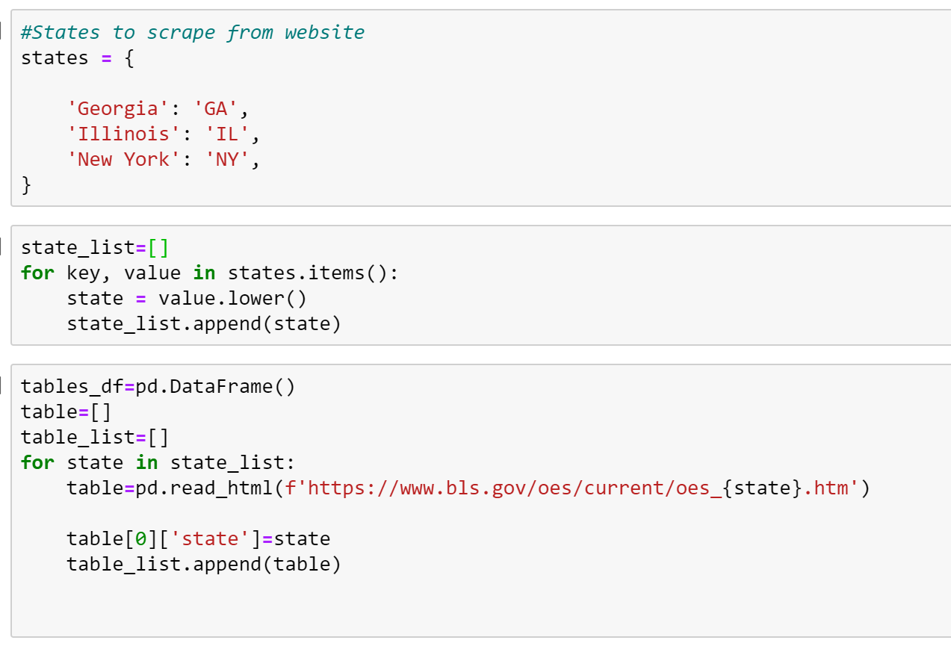
Extract
The extraction method used was web scraping with pandas.
Relevant states were put into a list and changed to lowercase to they would match the abreations used on the website url.
A loop was set up so pandas would scrape each state’s page. All of the data is place in one table
A column was adding to the end of the table to indicate the state that particular row of data belongs to.

Slide 5
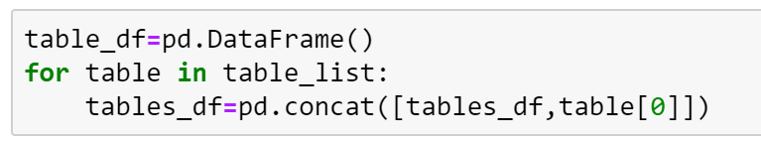
Transform
Several steps were followed to clean up the data such as:
Filtering dataframe to only include majors.
The dash in the column occupation code was removed
All of the $,(,),% were taken from the columns with numbers to convert them from a string to a float to later input them into MongoDB
The index was reset
Titles of the columns from changed

Slide 6
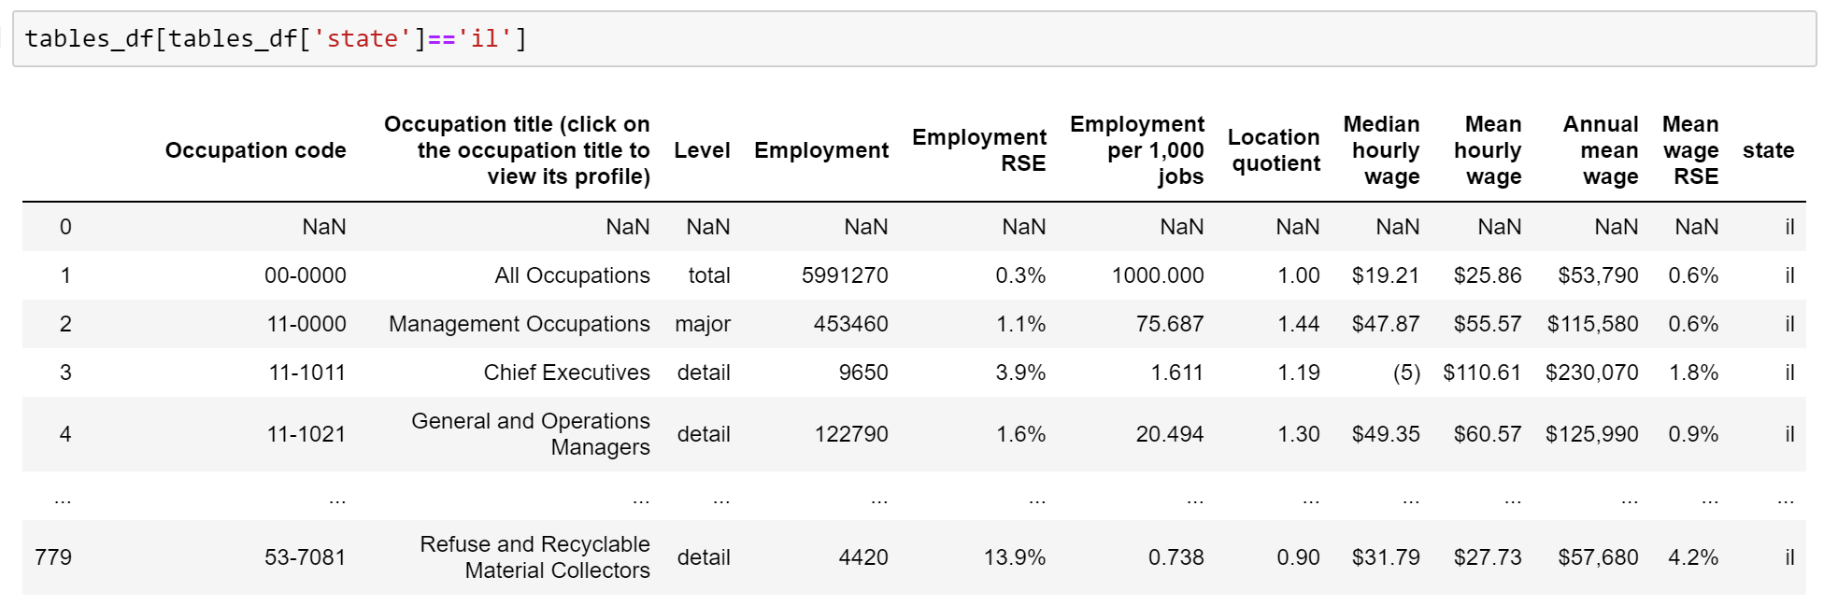

Slide 7
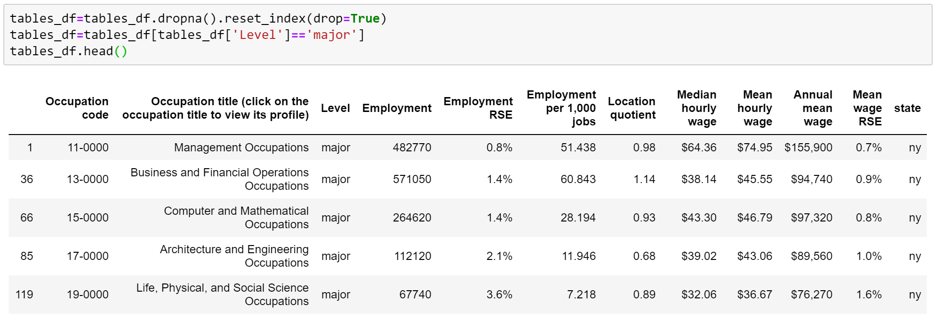
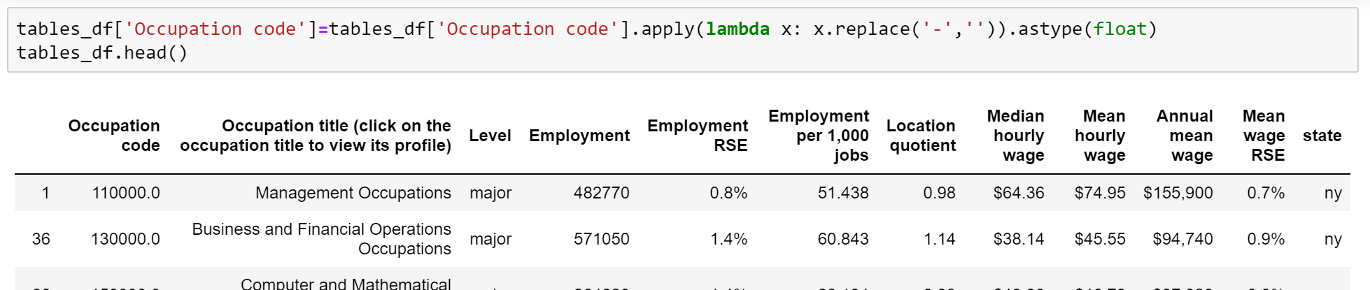

Slide 8
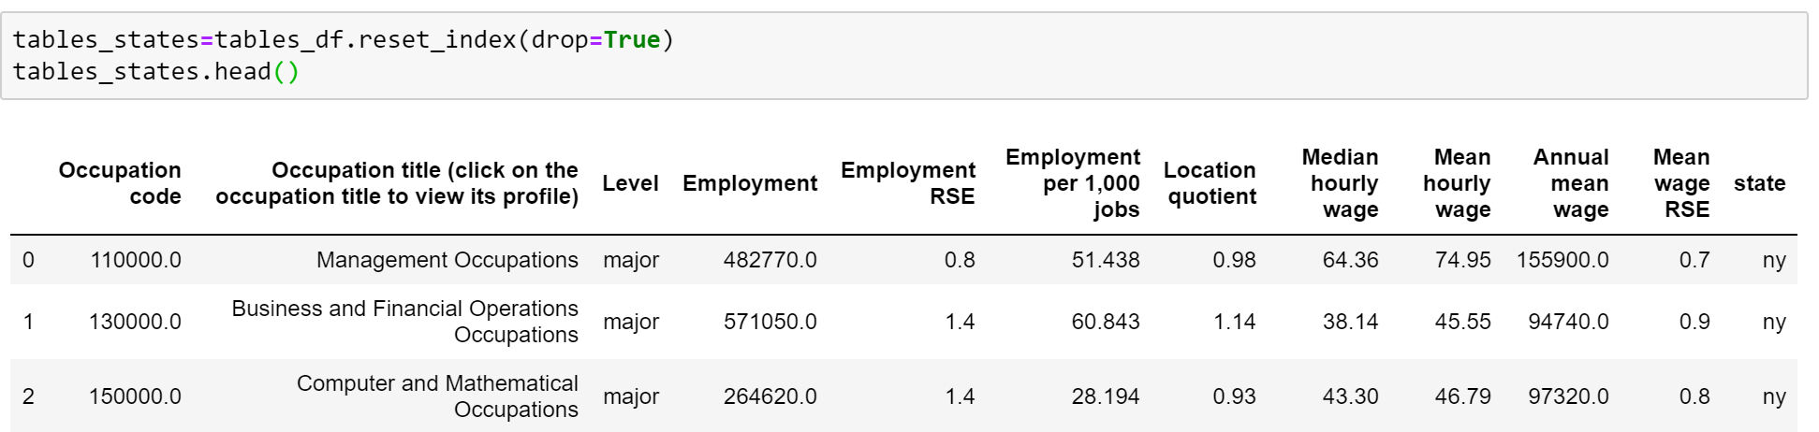
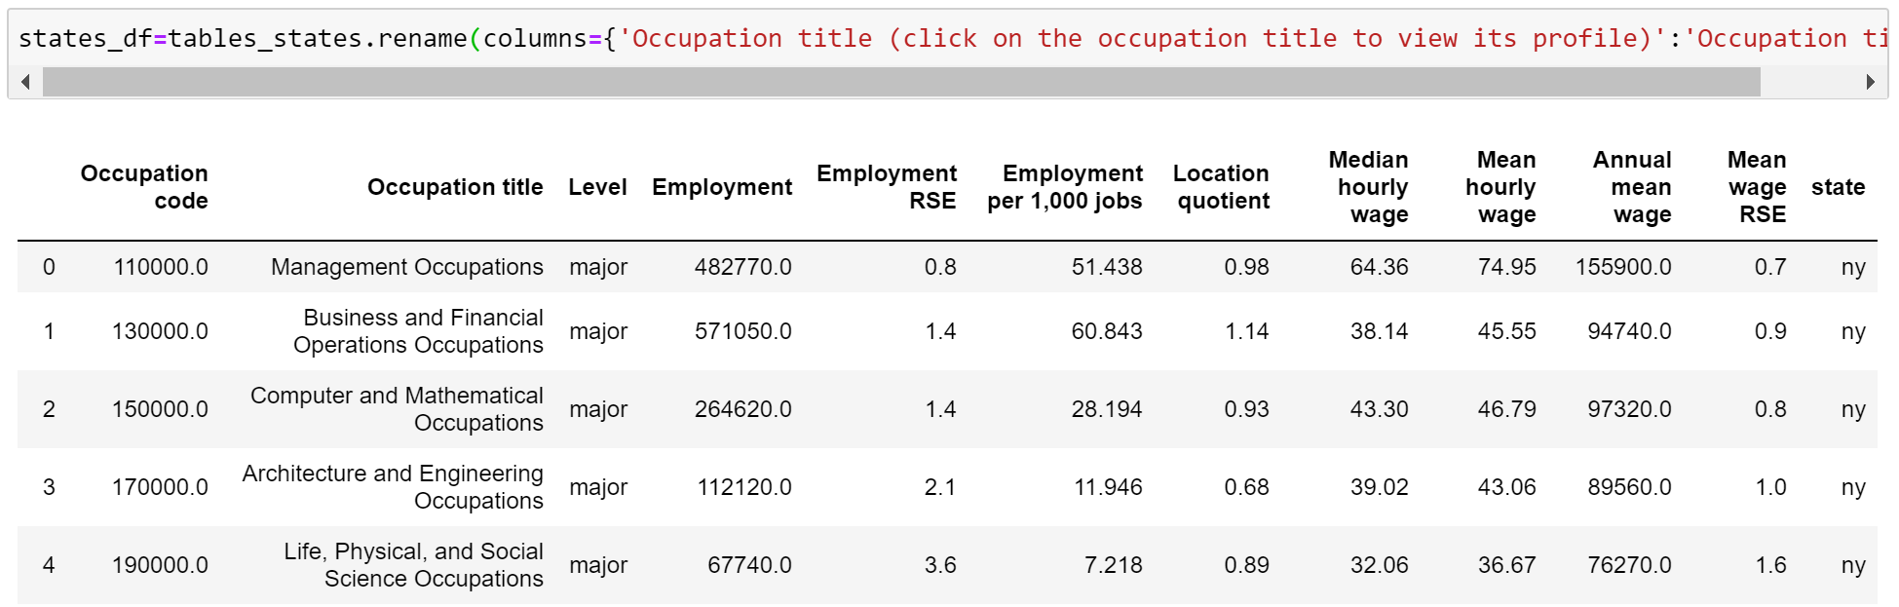

Slide 9
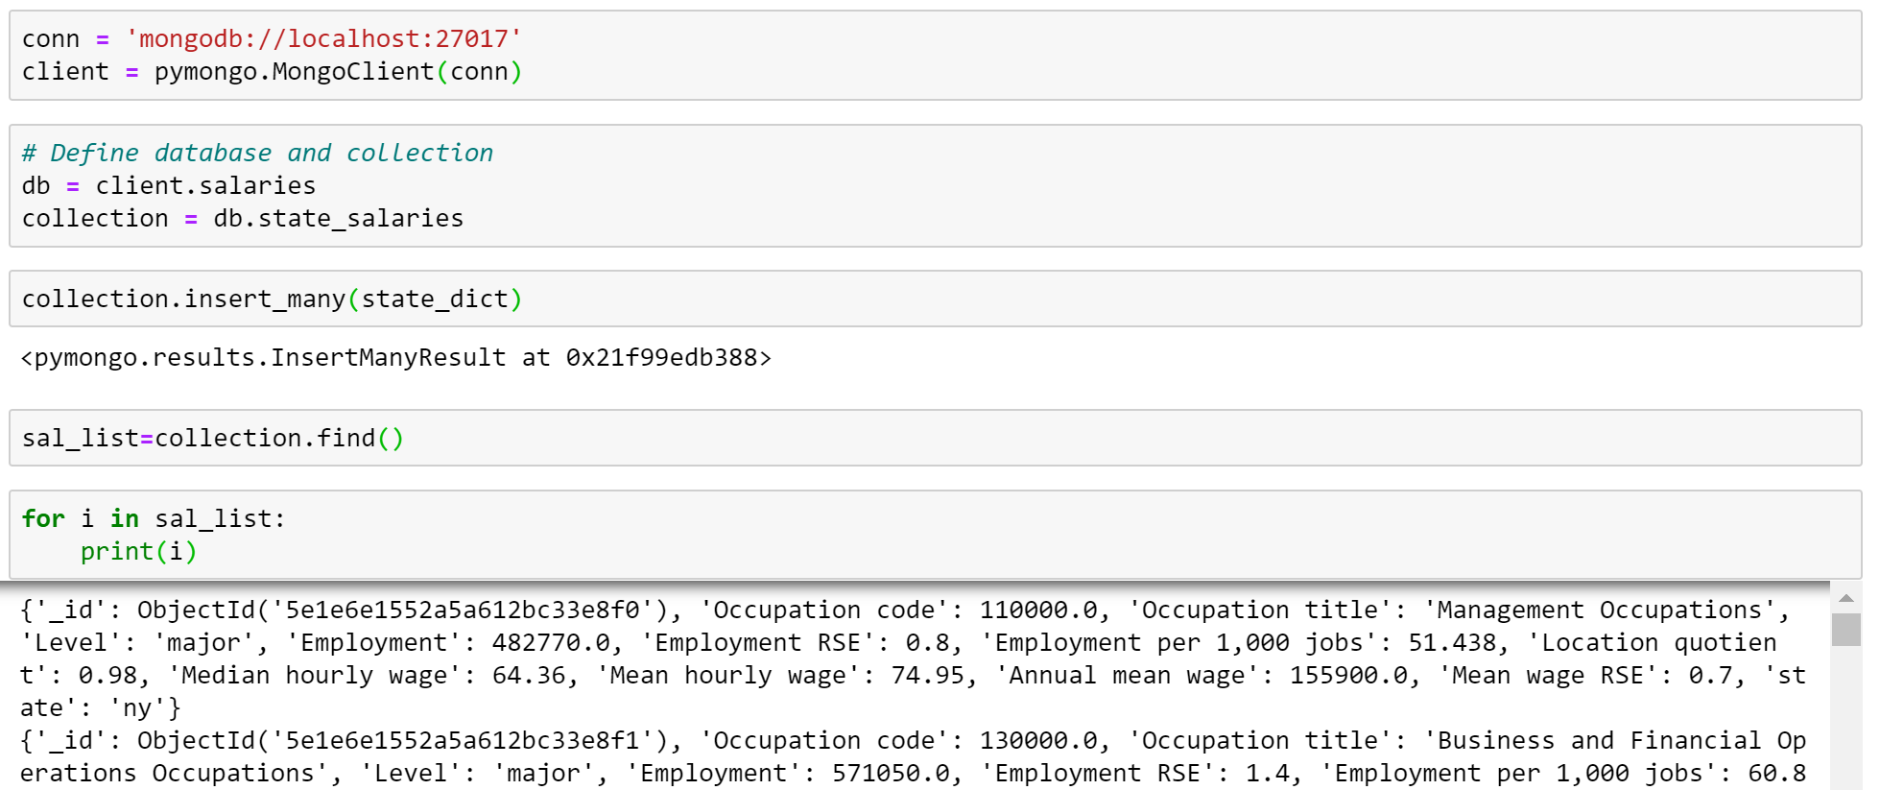
Load
MongoDB was the tool chosen to load the data dictionary into.
PyMongo is used on jupyter notebook to connect the newly cleaned information into MongoDB.

Slide 10
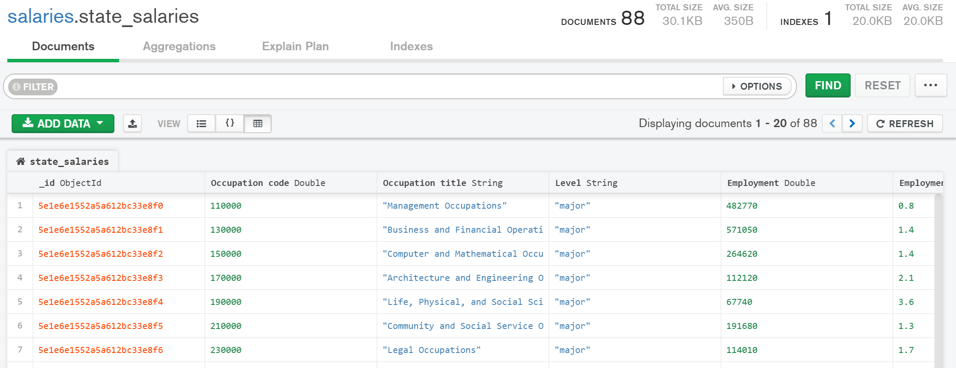
MongoDB Collection

